Slide 1
SC1015 Mini Project
FCSG Team 1
Goh Jun Keat U2320114E
Celeste Ho Shir Chee U2322765G
He QiXin U2321190F

Slide 2
Table of contents
01
02
03
04
05
Motivation
Data Cleaning
EDA
Are Data Science Professionals getting paid above the median salary (USD)?
Preparation of Dataset
Breakdown & Analysis of Variables
Models
Findings
Binary Classification
Random Forest
Logistic Regression
Conclusion &
Data-Driven Insights

Slide 3
01
Motivations
Data Science Salaries

Slide 4
Motivations
The field of Data Science is increasingly popular in this digitalised world.
More people are interested in becoming Data Science professionals.
Data Science remains a relatively new field with many uncertainties:
Uncertainty about job opportunities.
Few potential work locations
Some Data Science jobs pay more than others
Aim:
To investigate why some data science professionals are getting paid more than others
To gather more insights into Data Science related professions

Slide 5
Dataset
Dataset used: “Data Science Salaries” by Zain Faisal
Used data of Data Science Professionals from 3 years:
Total of 606 respondents across 2020, 2021 and 2022.
Dataset includes 12 columns based on the respondent’s profile:
9 columns contribute to the respondent’s salary and salary (USD).

Slide 6
02
Data Cleaning
Preparation of Dataset

Slide 7
Data Cleaning
Checked for missing values and duplicates.
Removal of Unnecessary Columns:
“id”, “salary”, “salary_currency”, “employee_residence”
For standardisation of salaries in USD.
Renaming of Values in Columns:
For better understanding of the data
Addition of New Columns:
“job_category” to categorise the many different Data Science jobs.
“above_median” to know if respondent has above median salary (USD).

Slide 8
03
Exploratory Data Analysis
Breakdown & Analysis after Data Cleaning

Slide 9
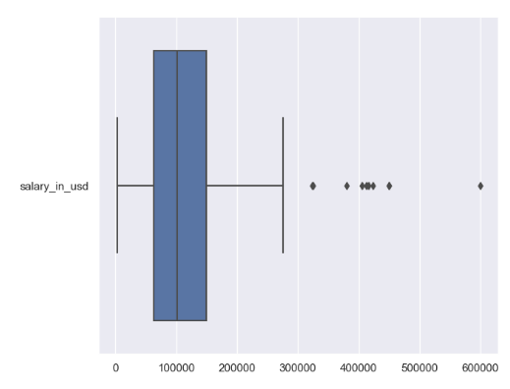
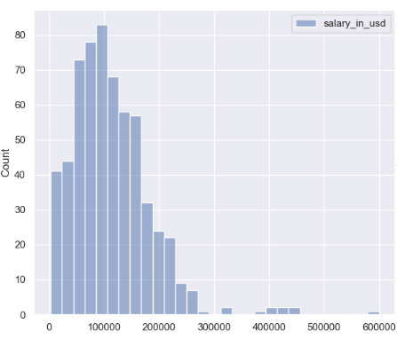
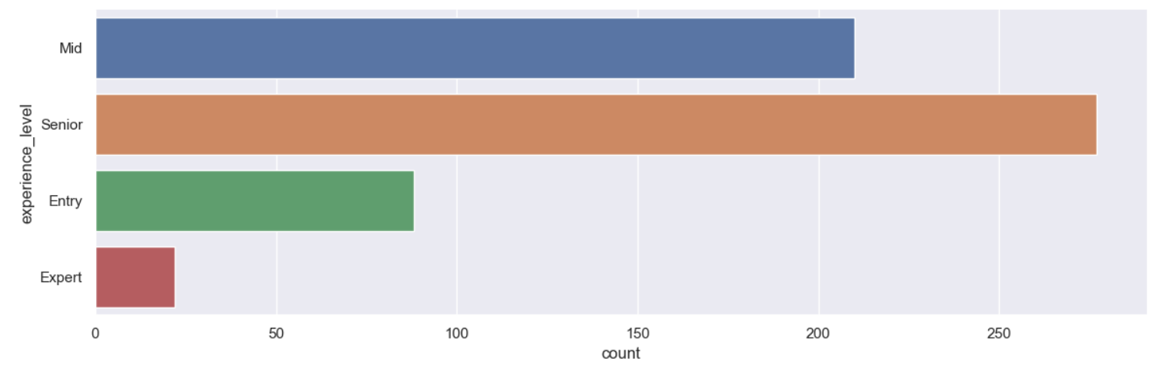
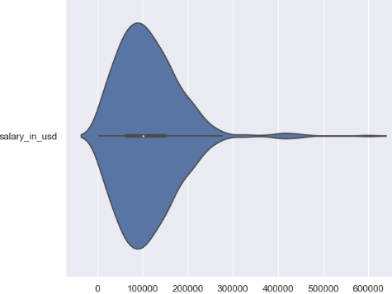
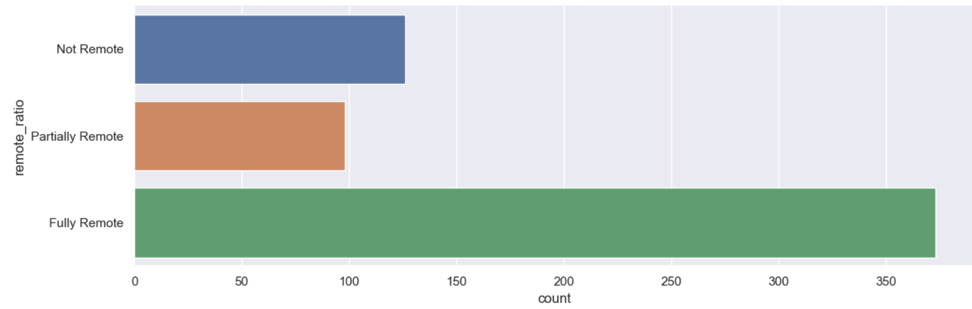
Breakdown of Variables
Numeric
Categorical
2 numeric variables
Only 1 truly considered numeric
Used box-plot, violin-plot, histogram.
7 categorical variables
Used catplot to plot distribution of each variable

Slide 10
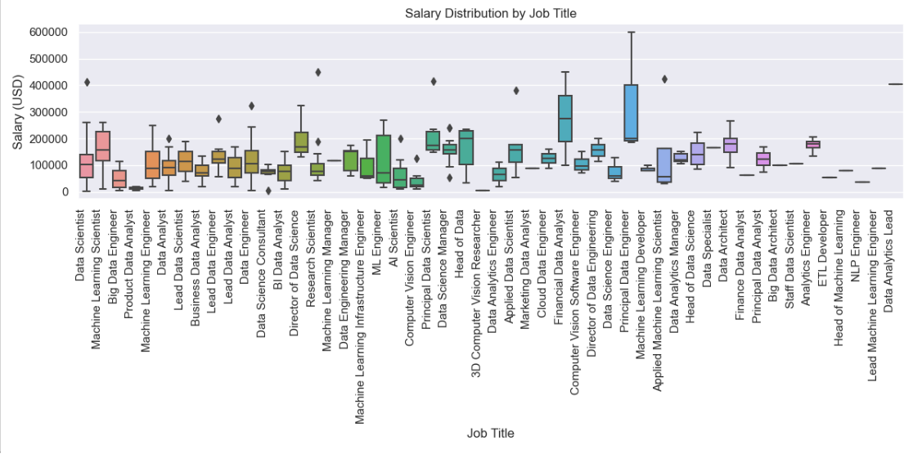
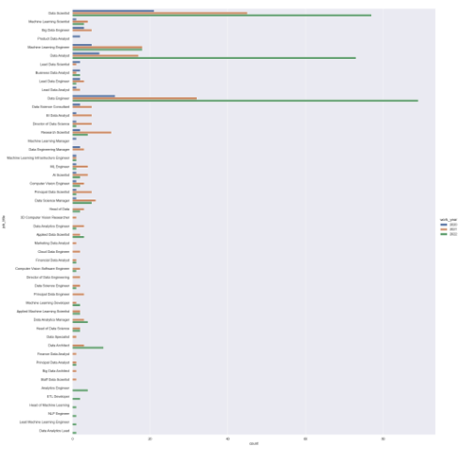
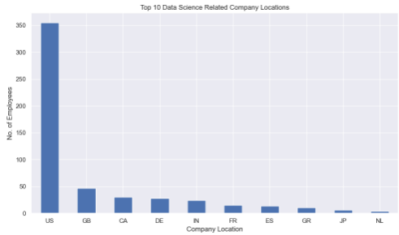
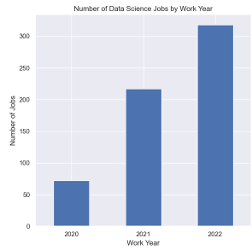
Analysis of Variables I
Boxplot
Barplot
Catplot
Distribution of salary (USD) by job title
Top 10 data science company locations
Trend of job opportunities by year
Most popular job title & job category by year

Slide 11
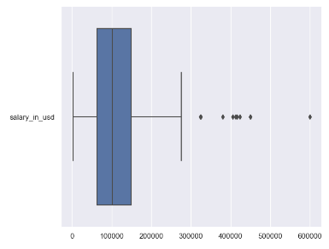
Outliers
Variable “salary_in_usd” has outliers that can be detected by boxplot.
Outliers were dropped to increase reliability
10 rows of data were dropped

Slide 12
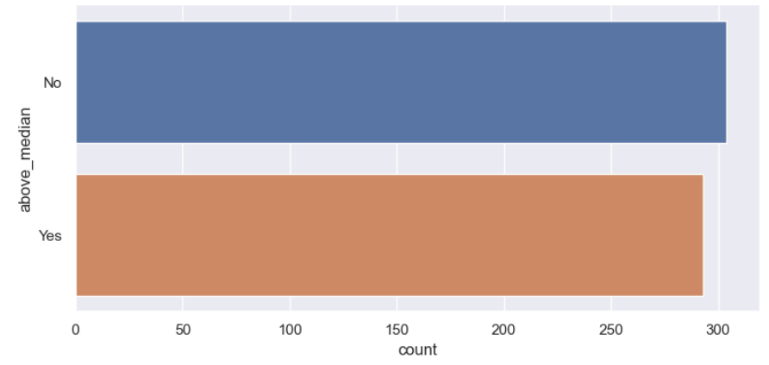
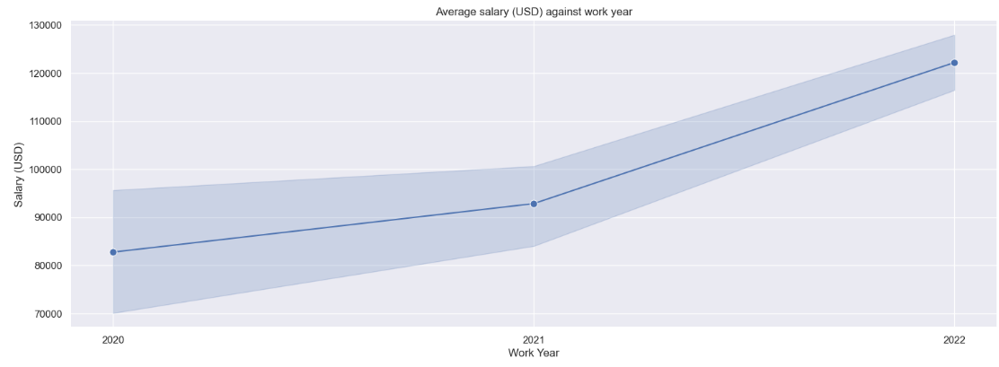
Analysis of Variables II
Catplot
Line Graph
Distribution of responding variable “above_median”
Trend of average salary (USD) by year
Median value used is the median value from raw data (before removing outliers)

Slide 13
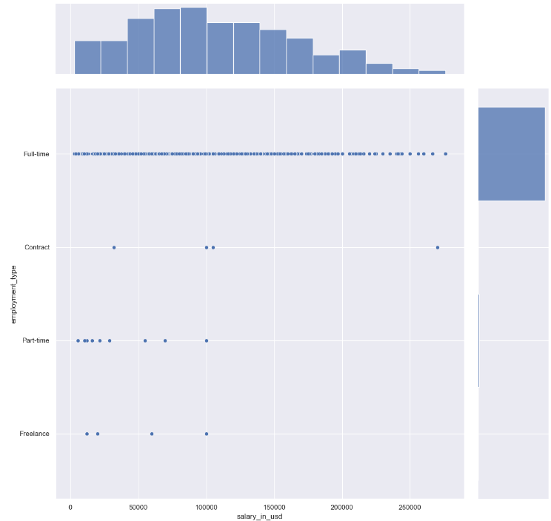
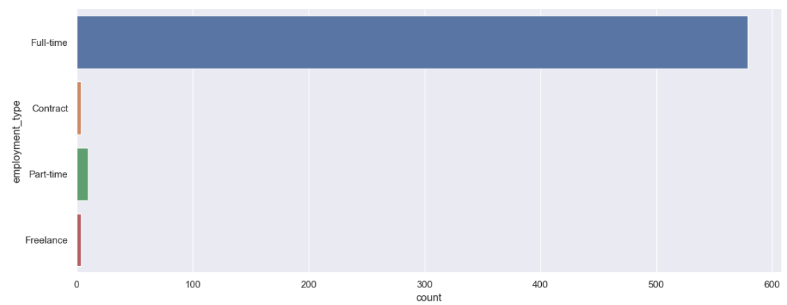
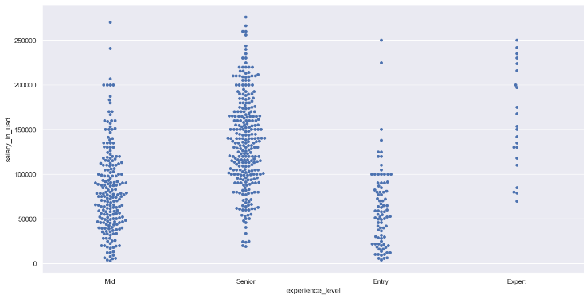
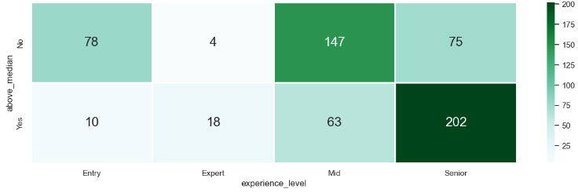
Predictors
6 potential predictors for “above_median”
Used catplot and jointplot to identify valid predictors.
3 valid predictors found. (experience_level, remote_ratio, company_size)
Used swarmplot to find distribution of valid predictors with salary (USD).
Categorise valid predictors against “above_median” using heatmap and GroupBy.

Slide 14
04
Models
Prediction Accuracy
Notes:
Next, ill be introducing the models.

Slide 15
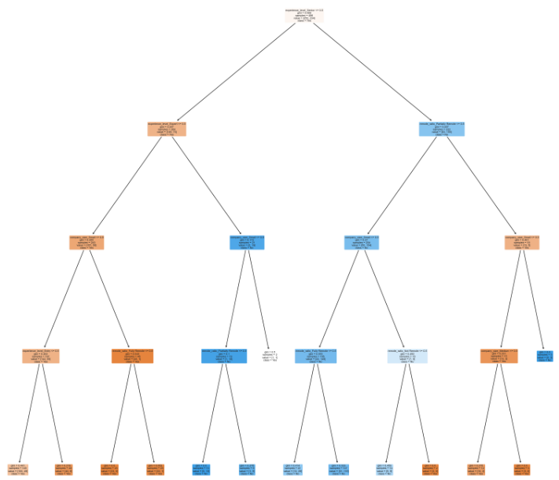
Binary Classification
Encoded the valid predictors by One-Hot Encoding.
Dataset split into Train and Test by ratio 8:2
Max depth set to 4
Upsampling done to increase accuracy
Analysis:
Accuracy: 72.95%
False Positive Rate (FPR): 21.15%
False Negative Rate (FNR): 31.43%
Notes:
Firstly, we have the binary classification model.
A binary classification model in Python is a machine learning model used to classify instances into one of two classes or categories.
In our project we used Decision trees. It partitions the feature space into regions based on feature values and classify instances according to the majority class in each region.
They are intuitive and easy to interpret but can be prone to overfitting.
In our code, we encoded the valid predictors by one hot encding.
We then split the dataset into Train and Test by the ratio 8:2, with the max depth set to 4.
In this model, unsampling was done to increase the accuracy of it.
To analyse this model, let us look at the statistics.
It has a 72.95% accuracy rate. 21.15% false positive rate and a 31.43% false negative rate.

Slide 16
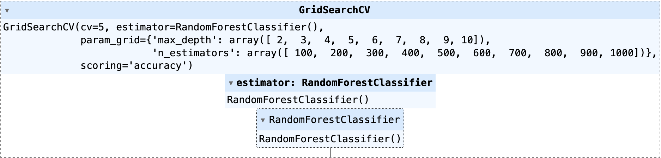

Random Forest
The dataset was split into Train and Test by ratio of 8:2.
300 decision trees with depth 5 (chosen via hyper-paramater tuning using Cross-Validation (CV), using accuracy as the scoring parameter)
Analysis
- Accuracy: 81.97%
- False Positive Rate (FPR): 17.31%
- False Negative Rate (FNR): 18.57%
Notes:
Next, we have the random forest model.
Random Forest is an ensemble learning method that builds multiple decision trees and combines their predictions to improve accuracy and generalization. It reduces overfitting compared to individual decision trees.
Random Forest builds multiple decision trees during training. Each tree is trained on a bootstrap sample of the training data, which involves randomly selecting instances from the training data with replacement.
In this model, the dataset was split In the same way as the previous model. 300 decision trees with depth of 5 were generated. These 300 decision trees were chosen via hyper-parameter tuning using cross-validation (CV), using accuracy as the scoring parameter.
For this model, it has much higher accuracy as compared to the binary classification model at 81.79%.
It has a false positive rate of 17.31% and a false negative rate of 18.57%
Both of which are lower than that of the binary classification model.

Slide 17
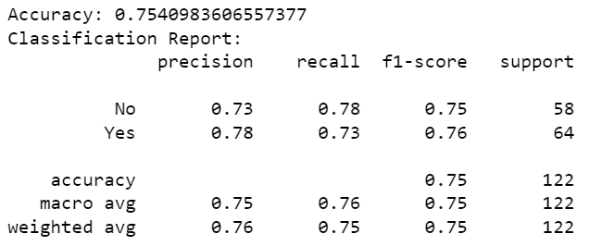
Logistic Regression
The dataset was split into Train and Test by ratio of 8:2.
After training, the code uses the trained model to make predictions on the testing data using “predict()”.
Analysis of Test data:
- Accuracy: 75.41%
- False Positive Rate (FPR): 44.83%
- False Negative Rate (FNR): 37.50%
Notes:
Lastly, we have the logistic regression model
It models the probability that an instance belongs to a particular class using a logistic function.
Logistic regression estimates the probability that an instance belongs to a particular class.
After training, the code uses the trained model to make predictions on the testing data using ‘predict()’ .
For this model,
It has an accuracy of 75.41%. A false positive rate of 44.83% and a false negative rate of 37.5%.
While it does not have the lowest accuracy out of the 3 models, it has the highest false negative and or positive rates.

Slide 18
05
Findings
Conclusion & Data-Driven Insights
Notes:
Moving on to our findings

Slide 19
Conclusion
Binary
Classification
Random
Forest
Valid predictors can predict whether salary (USD) of respondent is above median
Valid predictors can predict whether salary (USD) is above median and has the lowest false positive and false negative rates.
Logistic
Regression
Valid predictors can predict whether salary (USD) is above median salary (USD). This model has the highest false positive and false negative rates out of the 3 models.
Random Forest is the more suitable model to predict whether salary (USD) of Data Science professional is above the median salary (USD) as it has higher accuracy.
Notes:
To conclude and summarise the 3 models we have used:
The binary classification model allows for valid predictors to predict whether salary of respondent is above median.
The random forest model allows for valid predictors to predict whether salary of respondent is above median and it has the lowest false positive and false negative rate.
The logistic regression model allows for valid predictors to predict if the salary of a respondent is above median salary. However, this model has the highest false positive and false negative rate out of the 3 models that we have used.
Thus, out of the 3 models, the random forest model is the most suitable model to predict whether the salary of a data science professional is above the median salary or not as it has the highest accuracy and lowest false positive and negative rates.

Slide 20
Data-Driven Insights
Different Data Science jobs have different distribution of salary (USD).
Financial Data Analysts have the highest median salary (USD).
Principle Data Engineers have the highest minimum salary (USD).
Most popular job in:
2020 & 2021: Data Scientist
2022: Data Engineer
Most popular job category in:
2020 & 2021: Data Scientist
2022: Data Analyst
Most Data Science-related companies are found in the USA.
The average salary (USD) of Data Science professionals is increasing by year.
There are increasing number of job opportunities in the Data Science field by year.
Notes:
Before I end off this presentation, I would like to share some data-driven insights that we got from the dataset.
We found that financial data analysts have the highest median salary while principle data engineers have the highest minimum salary.
We also found that data scientist was the most popular job in 2020 and 2021 and data engineer was the most popular job in 2022.
The most popular job category in 2020 and 2021 was data scientist and data analyst in 2022.
In general, the data showed that most data-science related companies are found in the united states of America and that the average salary of data science professionals is increasing annually.

Slide 21
Thank you

Slide 22
References
https://stackoverflow.com/questions/57165247/rename-column-values-using-pandas-dataframe
https://www.dataquest.io/blog/tutorial-add-column-pandas-dataframe-based-on-if-else-condition/
https://www.geeksforgeeks.org/how-to-customize-line-graph-in-jupyter-notebook/
https://www.w3schools.com/python/python_ml_logistic_regression.asp
https://realpython.com/logistic-regression-python/
https://towardsdatascience.com/random-forest-in-python-24d0893d51c0
https://medium.com/@24littledino/accuracy-in-python-980074154e52

